Slide 1
Intelligent Alarm System of Driver Fatigue, based on Video Sequences.
Under the guidance of submitted by
Dr. Anupam Agarwal Rahul gupta (rit2011050)
Professor amit kumar (rit2011051)
IIIT ALLAHABAD Prashant joshi (rit2011056)

Slide 2
Introduction
Each year hundreds of people lose their lives due to traffic accidents around the world. Unfortunately, Iran ranks first in the world in terms of road fatalities and each year approximately thirty thousands of fellow countrymen lose their lives in these events [I].
In a study by the National Transportation Research Institute (NTSRB) in which 107 random car accidents had been selected, fatigue accounted for 58% of the all accidents. A main cause of fatigue is sleeplessness or insomnia.
Ad hoc networks were the first systems to develop the automatic navigation in cars [4] [5]. A noticeable weakness of these systems is that their responses to environmental changes is not real time.
It is especially important in driving where time is a critical factor in driver's decision. On the other hand, another method to check the driver fatigue is monitoring the physical condition and facial expressions of the drivers, which wireless sensor networks are unable to process and transmit these information with adequate precision

Slide 3
Motivation
A common activity in most people’s life is driving; therefore, making driving safe is an important issue in everyday life. Even though the driver’s safety is improving in road and vehicle design, the total number of serious crashes is still increasing.
Most of these crashes result from impairments of the driver’s attention.
Drowsiness detection can be done in various ways based on the results of different researchers.
The most accurate technique towards driver fatigue detection is dependent on physiological phenomena like brain waves, heart rate etc.
Also different techniques based on the behaviors can be used, which are natural and non-intrusive. These techniques focus on observable visual behaviors from changes in eyes.

Slide 4
Problem Definition
The system deals with using information obtained for the binary version of the image to find the edges of the face, which narrows the area of where the eyes may exist.
Once the face area is found, the eyes are found by computing the horizontal averages in the area. Taking into account the knowledge that eye regions in the face present great intensity changes, the eyes are located by finding the significant intensity changes in the face.
Once the eyes are located, measuring the distances between the intensity changes in the eye area determine whether the eyes are open or closed. A large distance corresponds to eye closure. If the eyes are found closed for more than number of threshold consecutive frames, the system draws the conclusion that the driver is falling asleep and issues a warning signal.
The system is also able to detect when the eyes cannot be found, and works under reasonable lighting conditions.
The system also works for the yawning and generates warning if a person is found yawning.
The system also generates warning when the head is lowered or is turned to different sides, for more than threshold consecutive seconds.

Slide 5
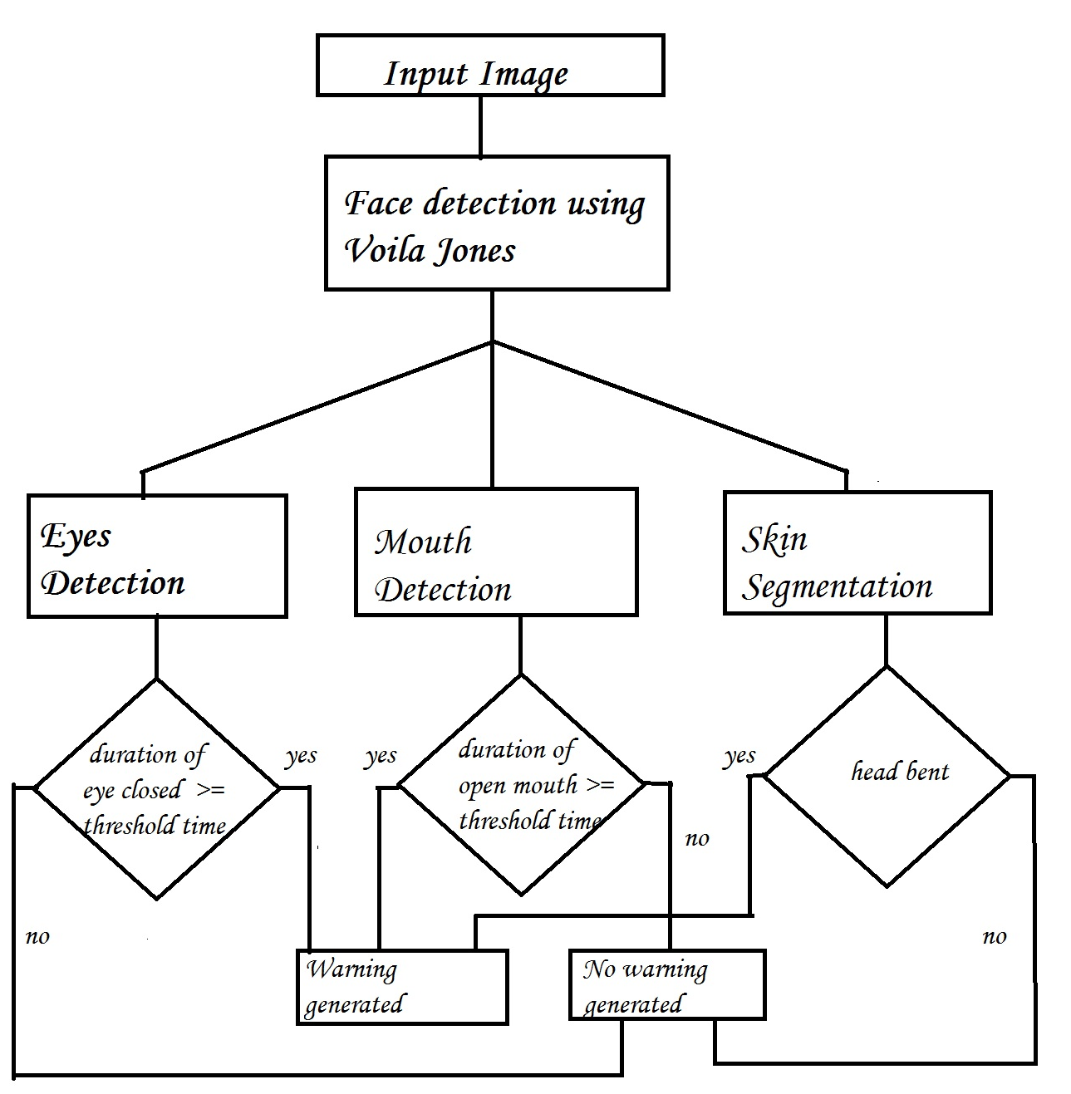
Proposed Approach
Flowchart of proposed method

Slide 6
Hardware & Software Requirements
The requirements for an effective drowsy driver detection system are as follows:
A non-intrusive monitoring system that will not distract the driver.
A real-time monitoring system, to insure accuracy in detecting drowsiness.
A system that will work in both daytime and nighttime conditions.
A dedicated system with about 1 GB RAM for the efficiency of the system because due to internal processes of computer, the application will run relatively slow.
The whole system is implemented on MATLAB.

Slide 7
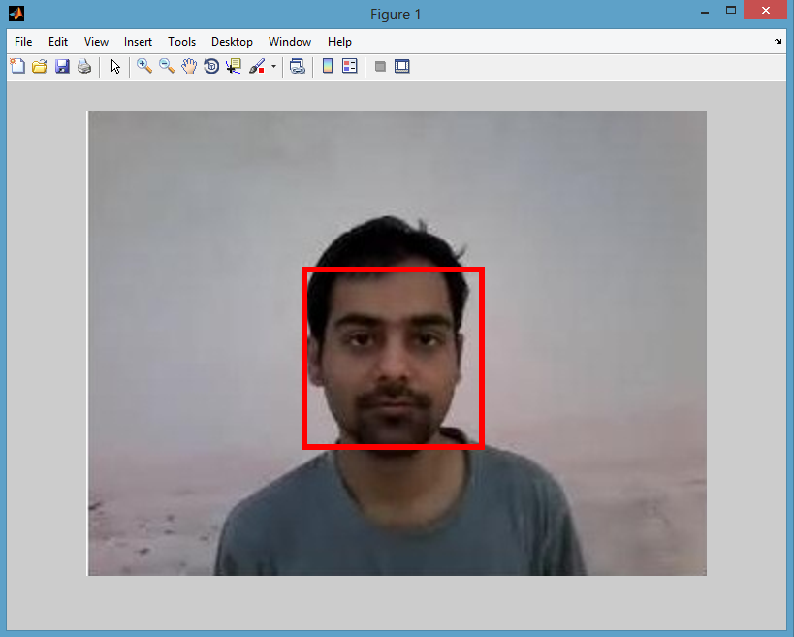
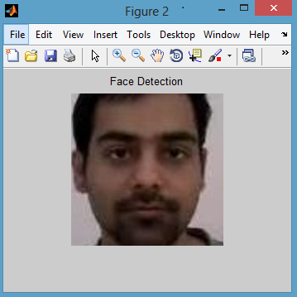
Face Detection using Voila Jones Algorithm
In the detection phase of the Viola–Jones object detection framework, a window of the target size is moved over the input image, and for each subsection of the image the Haar-like feature is calculated.[6]
This difference is then compared to a learned threshold that separates non-objects from objects
Face Region after Voila-Jones algorithm is applied. Cropped face region.

Slide 8
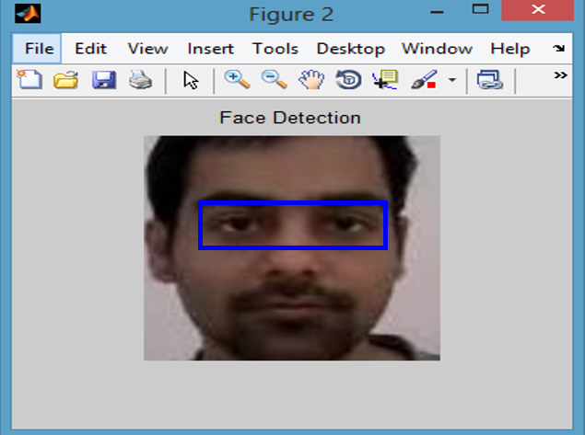
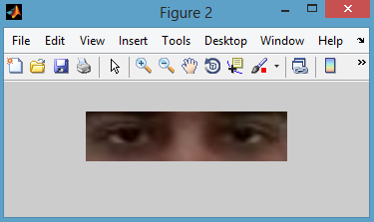
Eyes and Mouth Detection
After the face is detected using Voila-Jones, the region containing the eyes and mouth has to be separated.
To detect the coordinate from where the region of eye is starting certain calculations are done. After the rectangular window is extracted, we have considered that the eyes are located at a distance of (0.25 * height of window) from the top and (0.15 * width of window) from the left.
The size of window is (0.25 * height of window) in height and (0.68 * width of window) in width.
Eye Region after the calculations. Cropped eye region.

Slide 9



Eyes and Mouth Detection
After the eyes are cropped the image is coverted to YCbCr. The reason for conversion and way to convert is mentioned in “Skin Segmentation” column. Then image is converted to grayscale and ultimately to binary image by setting a threshold of (minimum pixel value + 10).
Image after converting to YCbCr Image after converting image to Image after converting image colour space grayscale. to binary image.

Slide 10




Eyes and Mouth Detection
Other scenarios of eye detection are
Original Cropped eyes Image after binarization

Slide 11
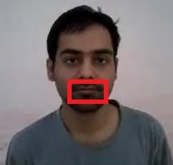
Eyes and Mouth Detection
To detect the coordinate from where the region of mouth is starting certain calculations are done. After the rectangular window is extracted, we have considered that the mouth are located at a distance of (0.67 * height of window) from the top and (0.27 * width of window) from the left.
The size of window is (0.20* height of window) in height and (0.45 * width of window) in width.
The region of mouth to be extracted. Cropped mouth region.

Slide 12



Eyes and Mouth Detection
Again the mouth is converted to YCbCr colour space, then it is converted to grayscale image and in turn converted to binary image with a threshold of (minimum pixel value + 10).
Mouth region converted to YCbCr After converting to grayscale image. After converting to binary image colour space.

Slide 13






Eyes and Mouth Detection
Other scenarios of mouth detection are :
Original cropped mouth
After binarization

Slide 14
Skin Segmentation
An image which taken inside a vehicle includes the driver’s face. Typically a camera takes images within the RGB model (Red, Green and Blue). However, the RGB model includes brightness in addition to the colours. When it comes to human’s eyes, different brightness for the same color means different colour.
When analyzing a human face, RGB model is very sensitive in image brightness. Therefore, to remove the brightness from the images is second step. We use the YCbCr space since it is widely used in video compression standards .
Since the skin-tone color depends on luminance, we nonlinearly transform the YCbCr colour space to make the skin cluster luma-independent. This also enables robust detection of dark and light skin tone colours. The main advantage of converting the image to the YCbCr domain is that influence of luminosity can be removed during our image processing.
In the RGB domain, each component of the picture (red, green and blue) has a different brightness. However, in the YCbCr domain all information about the brightness is given by the Y component, since the Cb (blue) and Cr (red) components are independent from the luminosity.

Slide 15
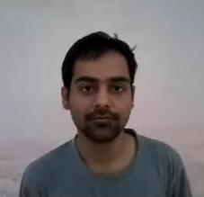
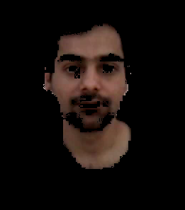
Skin Segmentation
Conversion from RGB to YCbCr
Cb = (0.148* Red) - (0.291* Green) + (0.439 * Blue) + 128;
Cr = (0.439 * Red) - (0.368 * Green) – (0.071 * Blue) + 128;
Conversion from RGB to HSV
MATLAB has predefined function for conversion of RGB color space to HSV color space.
I’ = rgb2hsv (I);
Image before skin segmentation.
Image after skin segmentation

Slide 16
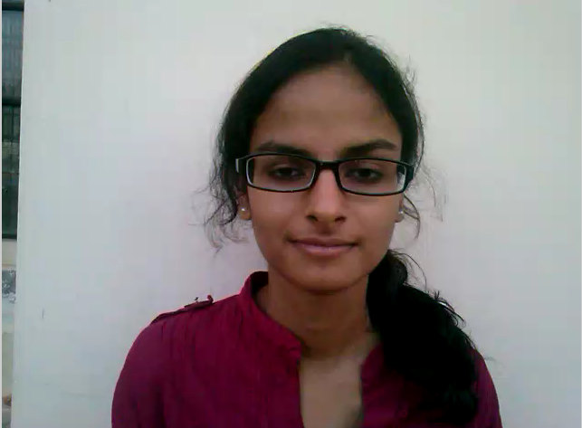
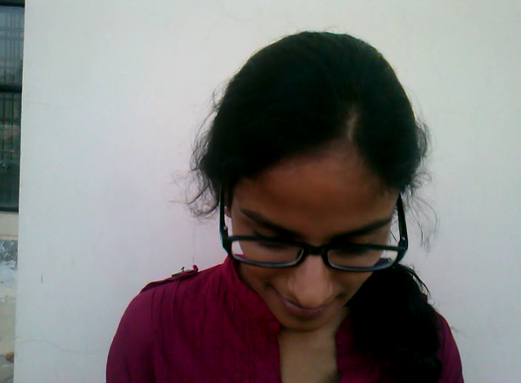
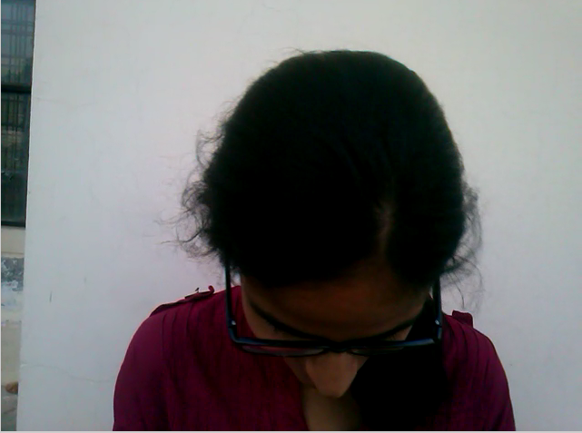
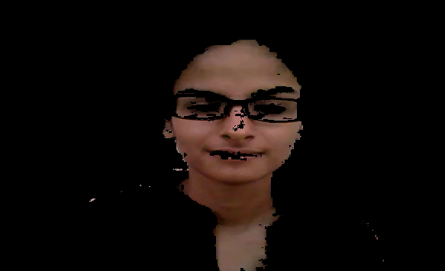
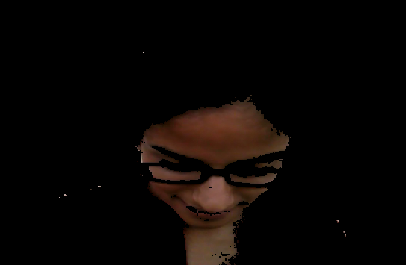
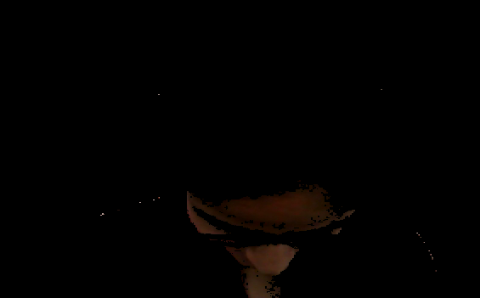
Skin Segmentation
For other scenarios, the segmentation would be like this.
Before Skin Segmentation
After Skin Segmentation

Slide 17
Skin Segmentation

Slide 18
Decision Making
The first frame is used for learning. All the results are calculated taking first frame as ideal frame.
Eyes Closed
When eyes are closed, the number of black pixels in binary image decreases considerably. If eyes are found closed for atleast 2 consecutive seconds (i.e. 2 * 16 = 32 frames, considering 16 frames per second), then the warning will be generated.
Mouth Open
When mouth is open, the resulting black pixels in binary image can be considerably larger or smaller than the ideal frame. The difference can be more than 6% of the black pixels in ideal frame.If mouth is found open for atleast 2 consecutive seconds (i.e. 2 * 16 = 32 frames, considering 16 frames per second), it means that the person is yawning and in response the warning will be generated.

Slide 19
Decision Making
Head Lowering
If the head is lowered, or turned around the number of skin pixels considerably decrease as compared to the ideal frame.If head is found lowered or found turned in other directions for atleast 2 consecutive seconds (i.e. 2 * 16 = 32 frames, considering 16 frames per second), it means that the person is vulnerable for accident and in response the warning will be generated.

Slide 20
Limitations of the algorithm
Objects in the video, should be uniformly illuminated, else results can differ.
Changing distance of person from the camera can cause problems.
Head lowering can give abrupt results in case of bald person.
The algorithm doesn’t work for the people sleeping with eyes open.
Face symmetry calculations are not same for everyone. The calculations considered are true for most of the people.

Slide 21
Accuracy
The algorithm is checked on about thirty videos of about 5-10 seconds.
The algorithm gives correct answer on about 25 videos that makes it about 83.33% accurate.

Slide 22
References
[1] G. Hosseini, H. Hossein-Zadeh, A "Display driver drowsiness Warning system", International Conference of the road and traffic accidents, Tehran University, 2006.
[2] L. M Bergasa, J. u. Nuevo, M A. Sotelo, R Barea and E. Lopez, "Visual Monitoring of Driver Inattention," Studies in Computational Intelligence (SCI), 2008.
[3] Viola, Jones: Robust Real-time Object Detection, IJCV 2001 pages 1,3.
[4] C. Zhang, X Lin, R Lu, P.H. Ho, X Shen, "An efficient message authentication scheme for vehicular communications". IEEE Trans Veh TechnoI57(6):3357-3368.2008.
[5] S. S. Manv M.S. Kakkasager J. Pitt, "MuItiagent based infonnation dissemination in vehicular ad hoc networks". Mobile Infonn Syst 5(4 ):363-389.2009.
[6] http://en.wikipedia.org/wiki/Haar-like_features

